Slide 1
Name: Mark Barry
Subject: Monitoring and Alerting
Topic: Building on Existing Roadmap
What I am looking for from the ITLT: Highlight one of the following
Decision/ Update/ Approval/ Direction/ Ideas
Date: 5/11/2012

Slide 2
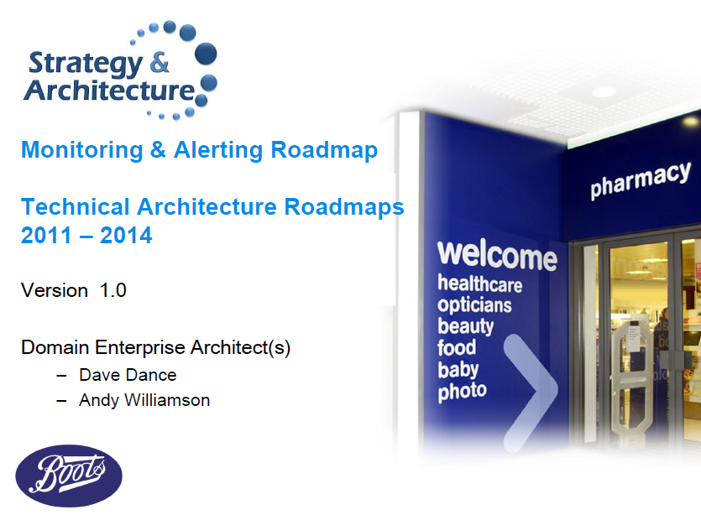
Recap
Roadmap published November 2011
Current state analysis
Market Trends
Vision and Target State
Enablers and Initiatives
Roadmap

Slide 3
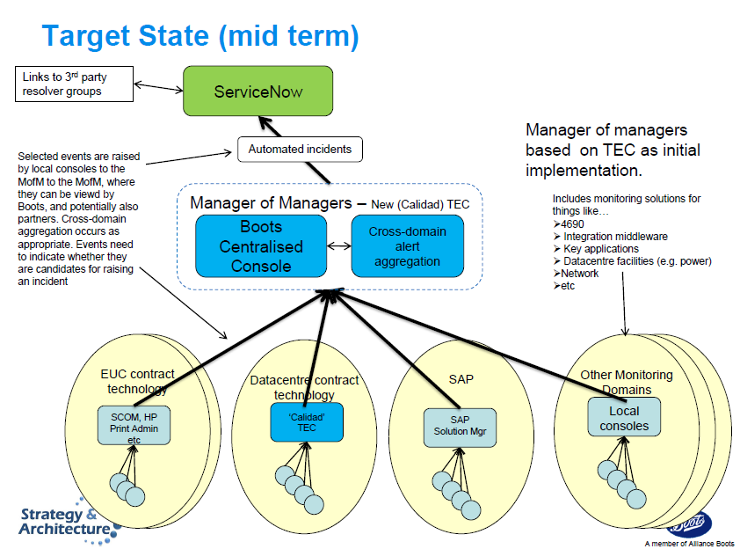
Target State
Technology focus
Use of Tivoli Enterprise Console as Manager of Managers
Access via IBM Callidad

Slide 4
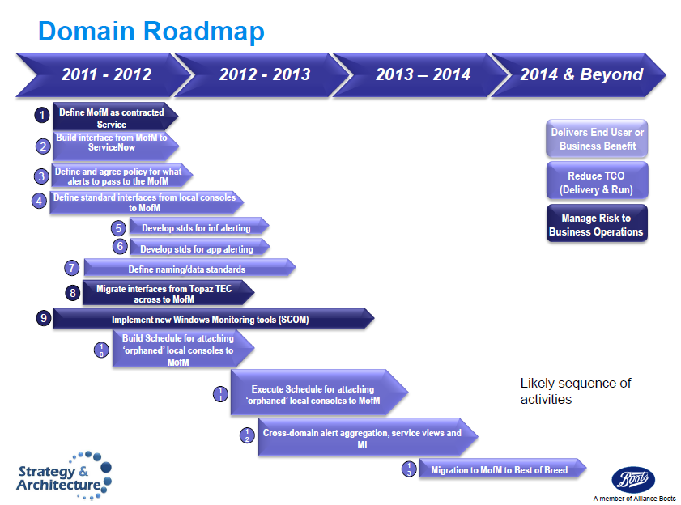
Roadmap

Slide 5

So what is our ambition ?
The best monitoring and alerting in the industry...
.... and is it matched by our commitment ?
££££’s

Slide 6
Three Themes of Build
Build a Capability
Build a core capability, not just a architecture component
Enable test and learn
Lead partners to engage
Role of Partners
Making use of log files to look out for specific alerts
Providing a Business Dashboard
Connecting IT to Critical Business Processes
Drill down to actual incident
Provide active dashboards via mobile devices and desktops

Slide 7
Simplified Model to Illustrate Thinking......
Service Now
Business Service Dashboard
Manager of Managers / Centralised Console
SAP
Other Apps
SAAS ?
Infra
Network
Data centre
Distributed

Slide 8
Build a Capability........
Linking critical business processes to IT service requires Boots knowledge
Core skills to understand hierarchies of and dependencies between IT services
IT Control Centre –
Best capability in Industry ?
Build or buy ?
Driving and influencing the partners is crucial to success
Current capability is difficult to access as embedded in contracts (e.g. Callidad)

Slide 9
Role of Partners
Partners will need to develop core capabilities
Use of tools to extract value from assets (e.g. Splunk and log files)

Slide 10
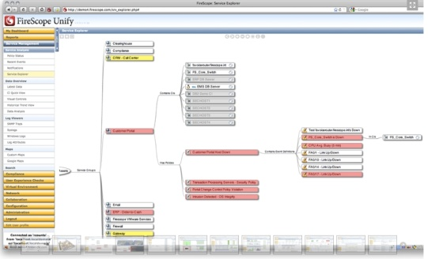
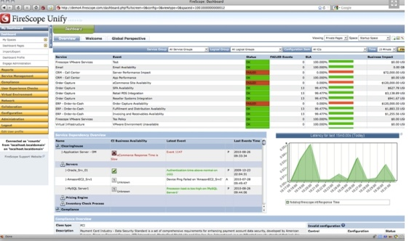
Business Service Manager
Dashboards – customised for areas of the business
Hierarchies

Slide 11

Proposed Next Steps
Complete review of current status and capability
Revise Vision, Target State and Roadmap
Review direction on Manager of Managers capability and solution
Confirm Business Service Dashboard requirement
Agree delivery sponsorship, funding and management

